Slide 1
Private equity fund
«Kazakhstan Investment Development Fund»
Brief about KIDF
Investment declaration
It was established in 2019 in accordance with the decree of the President of Kazakhstan and registered In the international financial center "Astana", which is governed by English law.
Target partners:Foreign investors (institutional and sectoral)
Amount of investments:no more than the amount of foreign partner's direct investments
Investment sectors:priority sectors of state programs;agriculture;infrastructure and PPP;services including tourism, logistics and it.
Investment restrictions:not more than 50% ownership in the invested company / asset (consolidated);projects/assets in primary mining, alcohol, tobacco, drugs and gambling sectors are not financed;""development projects from scratch" are funded only in conjunction with an industry investor with experience, expertise and/or access to markets.
Target rate of return:at least 5% on infrastructure assets;at least 15% on other assets.
Investment horizon:up to 20 years on infrastructure assets;up to 10 years on other assets.
Purpose:
Attraction of investments in development of economy of the Republic of Kazakhstan, by joint investment with foreign partners.
Direction of activity:direct investment in projects / assetspartnerships with similar funds
The Board of Directors includes:Prime Minister (Chairman);First Deputy Prime Minister-Minister of Finance;foreign Minister;Managing MFC;President;two independent Directors.Assets under management:The target value is 370 billion tenge (about $1 billion).)

Slide 2

“China silk Road”
Fund investment Fund
Briefly about PSP
Terms of agreement
PSP was established in 2014.
Investment sectors:
mining industryFerrous and non-ferrous metallurgyoil and gas (production and processing)Chemical and petrochemical industriesfinancial serviceenergy / renewable energyAgriculture, forestry and fishing, food industry.engineering.and other industries.
Investment restrictions:
the amount of financing in one project is not more than 20% of the total capital of the Fund.equity participation in one project should not exceed 70% of the total number of shares of the invested company .the ratio of debt to equity should not exceed 80: 20.the amount of investments for one industry should not exceed 30% of the total capital of the Fundfor equity investment projects, the estimated value of the IRR: at least 10%the Chinese content of the project, including but not limited to: engineering structures, equipment, product sales, technology exports and services provided by Chinese companies, should be at least 30%.with regard to direct lending and subsequent lending to projects, the interest rate will be determined depending on the status of the projects and negotiations with the relevant parties.
The agreement on creation of the China-Kazakhstan Fund of cooperation of production capacities (further – Fund) was signed on December 14, 2015, registered on December 7, 2016 in BeijingThe size of the capital 2 billion us dollars, 100% participation FSHP.
Purpose:
implementation of investment projects in the Republic of Kazakhstan.
Mandate:provision of investment Fund services on a medium-and long-term basis;equity investments;direct lending and re-lending through second-tier banks;project financing.

Slide 3




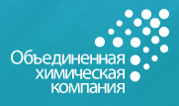
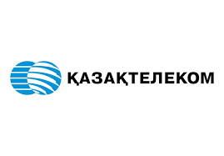







Financial support measures of JSC " NWF " Samruk-Kazyna»
JSC " NWF "Samruk-Kazyna" is an investment holding aimed at improving the national welfare of the Republic of Kazakhstan and supporting the modernization of the national economy. There are 12 portfolio companies in the Fund structure.
Briefly about " FNB " Samruk-Kazyna»»
JSC " NWF "Samruk-Kazyna" was founded in 2008 by the decree of the President of the Republic of Kazakhstan
Briefly about the structure of "NWF" Samruk-Kazyna»
The Board of Directors includes:
Chairman of the SD-Prime MinisterSD member-Assistant To the PresidentMember of the SD-Minister of national economyfour independent Directors;Chairman of the Board of JSC "NWF "Samruk-Kazyna" Tasks:improving the competitiveness, market value and profitability of the group's entities;implementation of best corporate governance practices;stimulation of development and implementation of innovative processes and technologies in the Fund group;participation in attraction of investments to the Republic, creation of conditions for investment activity of the group, development and implementation of investment strategic projects of national, inter-sectoral and regional scales
Net asset value, 2018
 | Oil and gas | 56,6 % | $ | 18 540
 | Industry | 8,5 % | $ | 2 794
 | Transport and logistics | 7,1 % | $ | 2 327
 | Financial asset | 11,5 % | $ | 3 753
 | Mining industry | 5,3 % | $ | 1 749
 | Energy | 6,4 % | $ | 2 086
 | Chemical industry | 0,6 % | $ | 192
 | Communication | 3,6 % | $ | 1 187
 | Realty | 0,3 % | $ | 109
 | Total | 100 % | $ | 32 737
At the end of 2018 JSC " NWF "Samruk-Kazyna" showed an increase in profitability (ROE) at the level of 8.0% compared to 6.5% in 2017 and reached the growth rate of international benchmarks such as Temasek Holdings (Singapore), Future Fund (Australia)
Financial indicators, billion tenge (2018):

Slide 4
Financial support measures of JSC " NWF " Samruk-Kazyna»
JSC " Samruk-Kazyna invest»
Investment decision making
The company adheres to the following step-by-step approach in the consideration of projects:
Preliminary analysis;
Due diligence of the project and (or) the portfolio company and assessment of investment risks on the project;
Due diligence due diligence of the project and (or) the project company);Participation in the authorized capital of a portfolio company;Organization of control and monitoring of investments;Exit of The company from the project.
Type of financing:
investments in fixed assetsPriority directionprojects in priority sectors of JSC " NWF " Samruk-Kazyna»;projects aimed at the development of intercompany cooperation;projects aimed at modernization of the economy of Kazakhstan;projects aimed at implementing the Concept of Kazakhstan's transition to a "green economy".
Geographical focus:
Kazakhstan and other countries, in case of production cooperation with
KazakhstanProject costs:
up to $ 150 million. USA. Investment term: 3-5 years (with the possibility of prolongation for three years)
Average return on investment portfolio: 12.54% per annum in tengeShare of "Samruk-Kazyna invest" LLP: up to 49% in the authorized capital
about the Institute:
Created on 20 July 2007100% owned by JSC "national welfare Fund "Samruk-Kazyna»
Status and mandate:
direct financing of investment projects aimed at creating competitive goods and services in order to increase the quality of local content.
Project management
The company manages the project and portfolio company as follows:
Opening a Bank account in order to control the intended use of money;
Organization and control of systematic and systematic reporting provided by the portfolio company;Participation in corporate governance of a portfolio company through representation in management bodies
Other forms of management not prohibited by law
Exits from investments
The company is considering four exit scenarios:
IPO (initial public offering);Sale to portfolio, institutional and strategic investors at market value;Sale of a stake to a strategic investor;Sale of the stake of JSC " NWF "Samruk-Kazyna" for the strategic development of the industry.

Slide 5
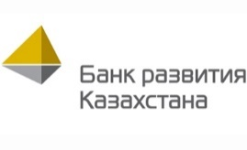

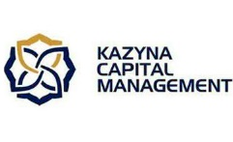



Financial support measures of “Baiterek holding” JSC
Types of instruments in the context of controlled organizations
Организация
Type of instrument
Medium-and long-term lending to large investment projects
Export/ pre-export lending
Crediting of current activities within the framework of implemented investment projects
Interbank lending instrument
Equity financing
Exporter's credit insurance
Pre-export financing
Trade finance
Loan insurance
Advance payment insurance
Equity financing
Design documentation development
Attraction of investors, organization of debt financing
Transfer and introduction of innovations
Development of small and medium enterprises
Project-based subsidies in the programmes
Lending
Guarantee

Slide 6
Financial support measures of “Baiterek holding JSC”
JSC " Kazyna Capital Management»
Tools– Funds
http://kcm-kazyna.kz/funds
about the Institute:
It was created in 2007 by the decree of the President of Kazakhstan.100% owned by the government of Kazakhstan through the sole shareholder-JSC "national managing holding "Baiterek", which is headed by the Prime Minister of Kazakhstan.
Status and mandate:
Development of private equity infrastructure in Kazakhstan to promote sustainable economic development of Kazakhstan.Formation of an independent cluster of management companies and funds for the effective development of private equity in Kazakhstan.
Portfolio:
KCM invests in promising and strategically important private equity funds. 14 private equity funds with KCM participation, including 5 active ones.7 funds were created on the initiative of the President and the Government of Kazakhstan.Traditional investment horizon-5 years
Aureos Central Asia Fund
(2007)
Macquarie Russia and CIS Infrastructure Fund
  (2009)
ADM Kazakhstan Capital Restructuring Fund
(2010)
Islamic Infrastructure Fund
(2009)
Small and medium businessThe capitalization of the Fund:$37 million.
Infrastructure projectThe capitalization of the Fund:$650 million.
Non-resource sectors of the economyThe capitalization of the Fund:$100 million.
Infrastructure projectThe capitalization of the Fund:$226 million.
Kazakhstan Growth Fund
(2009)
  Wolfensohn Capital Partners
  (2008)
CITIC Kazyna Investment Fund I(2010)
  DBK Equity Fund
Food, light industry, metallurgy, woodworking, etc, The capitalization of the Fund:$80.8 million.
Alternative energy and financial servicesThe capitalization of the Fund:$250 million.
Инфраструктурные проекты, недвижимость, разведка и добыча и др., кроме нефти и газа
Капитализация фонда:
$200 млн.
Projects of Development Bank of Kazakhstan and DBK-LeasingThe capitalization of the Fund:$100 million.
Russian-Kazakhstan Nanotechnologies Fund
(2008)
Falah Growth Fund
(2008)
  Baiterek Venture Fund
  (2014)
  Kazakhstan Infrastructure Fund (2014)
Внедрение инновацион-ной активности частного капитала, нанотехнологий
Капитализация фонда:
$51 млн.
нефтегазовый сервис, энергетика, недвижимость, финансовый, страховой сектор,
Капитализация фонда:
$500 млн.
Priority sectors SPIIDThe capitalization of the Fund:12.7 billion tenge.
Infrastructure and industry in the framework of the SIIDThe capitalization of the Fund:$105 million.
  Almex – Baiterek Fund*
  (2015)
Agriculture and food industry, industry SPIIDThe capitalization of the Fund:468 million tenge.
  KCM Sustainable Development Fund

Slide 7

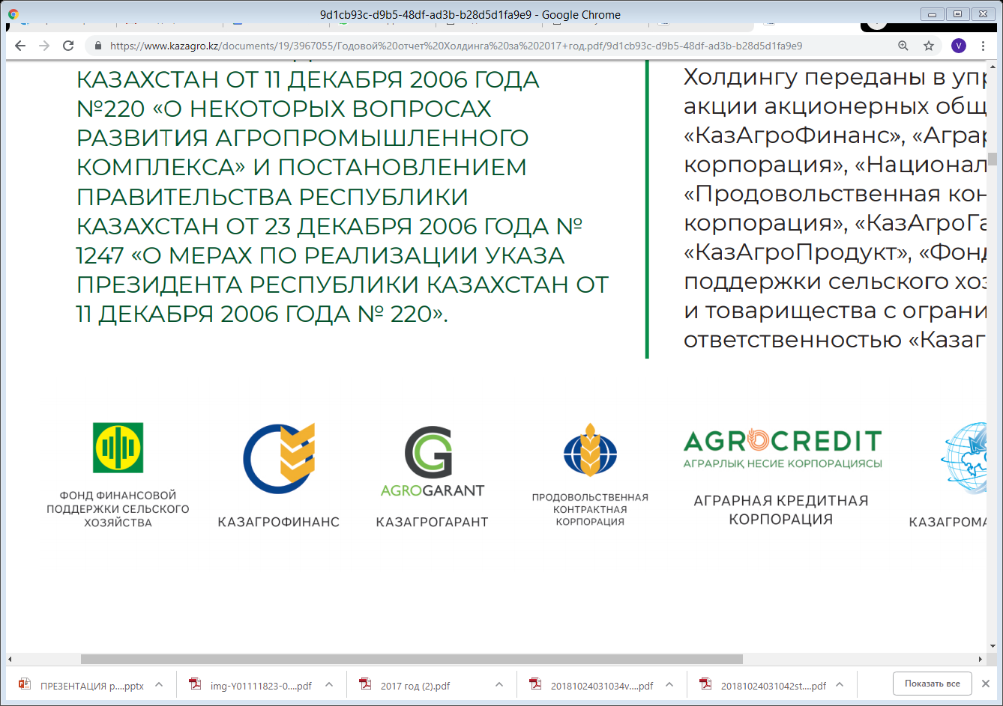
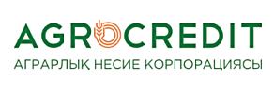
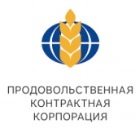
Financial support measures of JSC "holding" KazAgro»
JSC " NUH "KazAgro" is an integrated development Institute, which includes 4 subsidiaries that use a wide range of tools to support the subjects of agriculture of the Republic of Kazakhstan.
Briefly about " JSC " NUH " KazAgro»
JSC " NUH "KazAgro" was established in order to implement the state policy to stimulate the development of the agro-industrial complex of the Republic of Kazakhstan by the decree of the President of the Republic of Kazakhstan dated December 11, 2006 No. 220.
Briefly about the structure of "JSC" NUH KazAgro»
The structure of JSC "NUH "KazAgro" includes the following subsidiaries*:
Financial institutions involved in the financing of agro-industrial enterprises:
JSC “Agrarian credit Corporation", JSC "KazAgroFinance", JSC " Fund for financial support of agriculture»JSC "food contract Corporation", performing the functions of maintaining the reserve stock of grain in order to ensure food security of the country.
The Board of Directors includes:
Chairman of the SD-Deputy
Prime Minister-Minister of agriculture
Member of SD-Minister of Finance
Member of the SD-
Minister of national economy
Финансовые показатели, млрд. тенге (2018):
the structure on 01.08.2019 year also includes JSC "Holding", LLP "KazAgroMarketing", JSC "Kazagroproduct" in respect of which measures on liquidation and reorganization through merger with other subsidiaries of JSC "holding "KazAgro»

